Slide 1
Mktplace
Carlos Mercado | Josh Mitchell | Maks Pazuniak | Vivien Chen | Marc Bennet
Special thanks to: Preethi Kasireddy, Samee Siddiqui, Julian Martinez

Slide 2
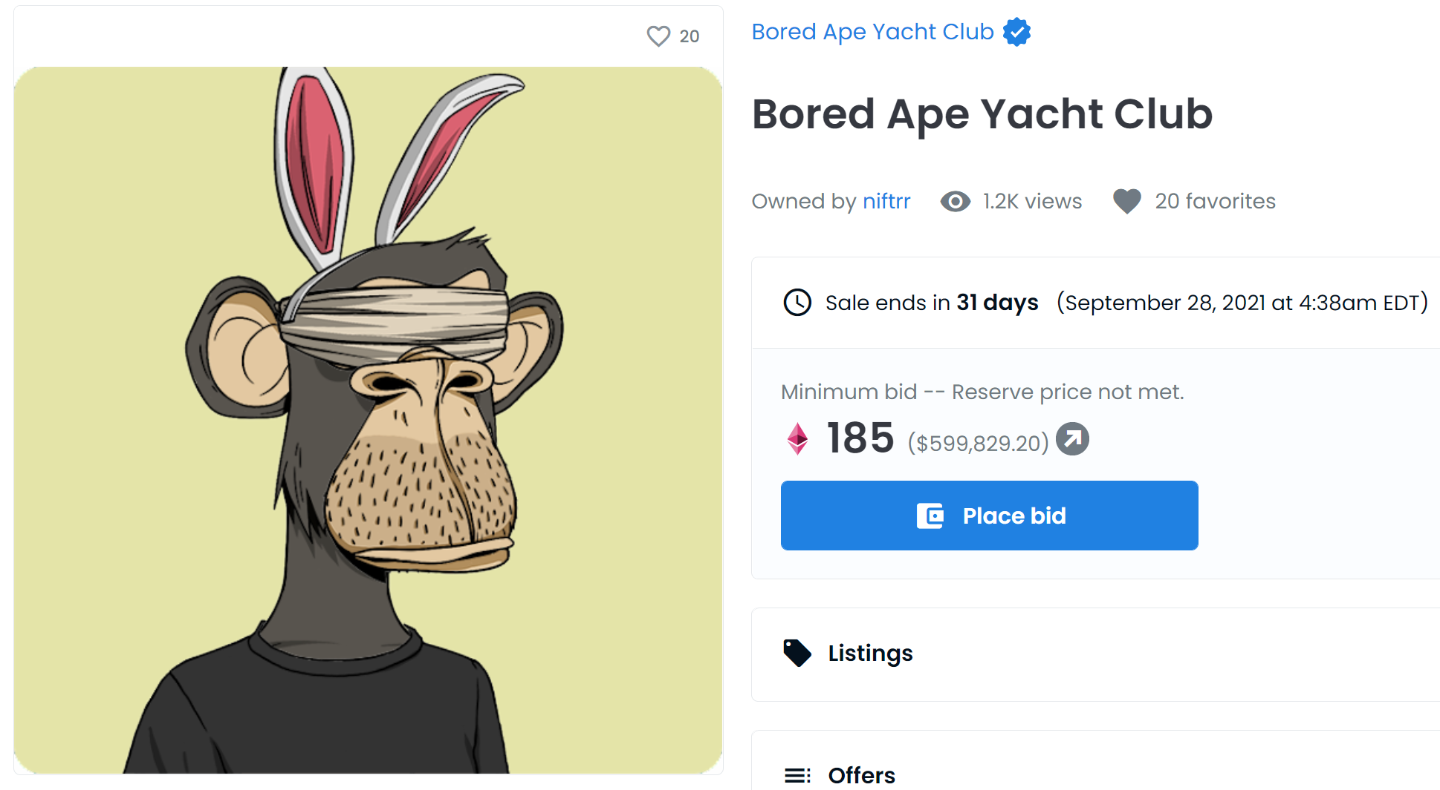
The Pitch
The NFT market has 2 big problems.

Slide 3
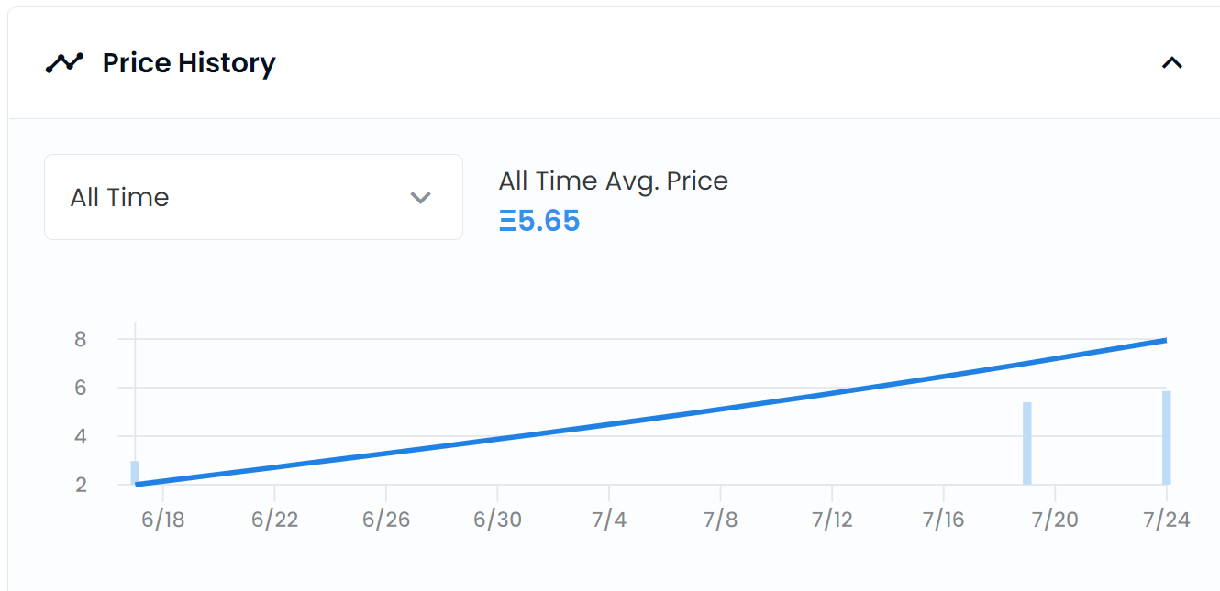
The Pitch
The NFT market has 2 big problems.
1. Volume is too low to accurately estimate value.
This BAYC has only sold 3 times.
The seller is only guessing it’s worth 185 ETH.

Slide 4
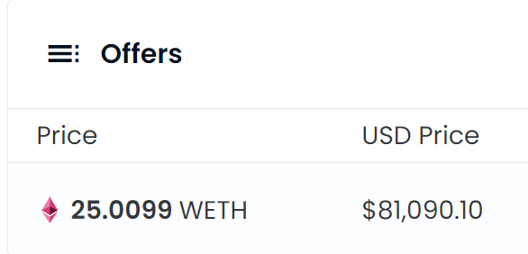
The Pitch
The NFT market has 2 big problems.
1. Volume is too low to accurately estimate value.
2. No incentive to place low-ball bids = No on-chain demand curves.
Why bother with this low-ball bid? The 25 ETH is stagnant & not generating yield. It can’t used by the seller to access debt.

Slide 5


The Pitch
Mktplace proposes certificate of deposit auctions for any arbitrarily complex vault (not just NFTs!) to solve both problems at once.
Mktplace

Slide 6
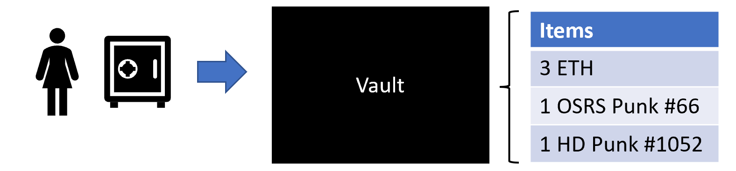
The Pitch
Alice puts some assets in a vault.

Slide 7
The Pitch
Alice puts some assets in a vault.
(Not just NFTs, any arbitrarily complex group of assets).
Not just NFTs Using fungible assets creates some interesting derivative effects…

Slide 8


The Pitch
She publishes the vault and people are interested.
$12,000!
$10,000

Slide 9

The Pitch
Mktplace adds a time-lock feature, turning all orders into limit orders.
$12,000!
How long is that offer good for?
$10,000

Slide 10
The Pitch
The bidders agree to lock their bid for their choice of weeks.
*This is the magic.
10 weeks
How long is that offer good for?
15 weeks

Slide 11
The Pitch
By agreeing to lock their bids, we turn their bid into a certificate of deposit.
Bidder | Bid | Certificate Length
Bobby | $12,000 | Weeks 1 – 10
Timmy | $10,000 | Weeks 1 – 15

Slide 12
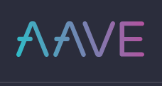
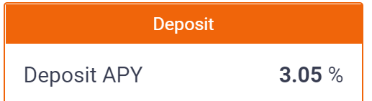
The Pitch
Bidder | Bid | Certificate Length
Bobby | $12,000 | Weeks 1 – 10
Timmy | $10,000 | Weeks 1 – 15
By agreeing to lock their bids, we turn their bid into a certificate of deposit.
And lock it into AAVE to earn interest.

Slide 13
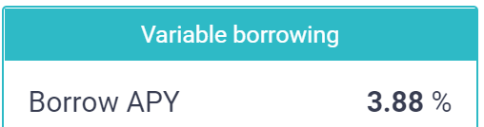
The Pitch
Weeks | Credit Limit
1 | $12,000
2 | $12,000
3 | $12,000
4 | $12,000
5 | $12,000
6 | $12,000
7 | $12,000
8 | $12,000
9 | $12,000
10 | $12,000
11 | $10,000
12 | $10,000
13 | $10,000
14 | $10,000
15 | $10,000
16 | $0
Getting yield while they hope to win Alice’s Vault.
The bids gives her access to debt.
She can sell immediately OR use the bids to take a loan.
Credit Limit “Curve”
Solves 3 Problems!
1. Yield incentivizes low-ball bids.
2. Low-ball bids give us a demand curve improving value estimation.
3. Alice can access debt through second party collateralization.
*Special checks
happen here

Slide 14
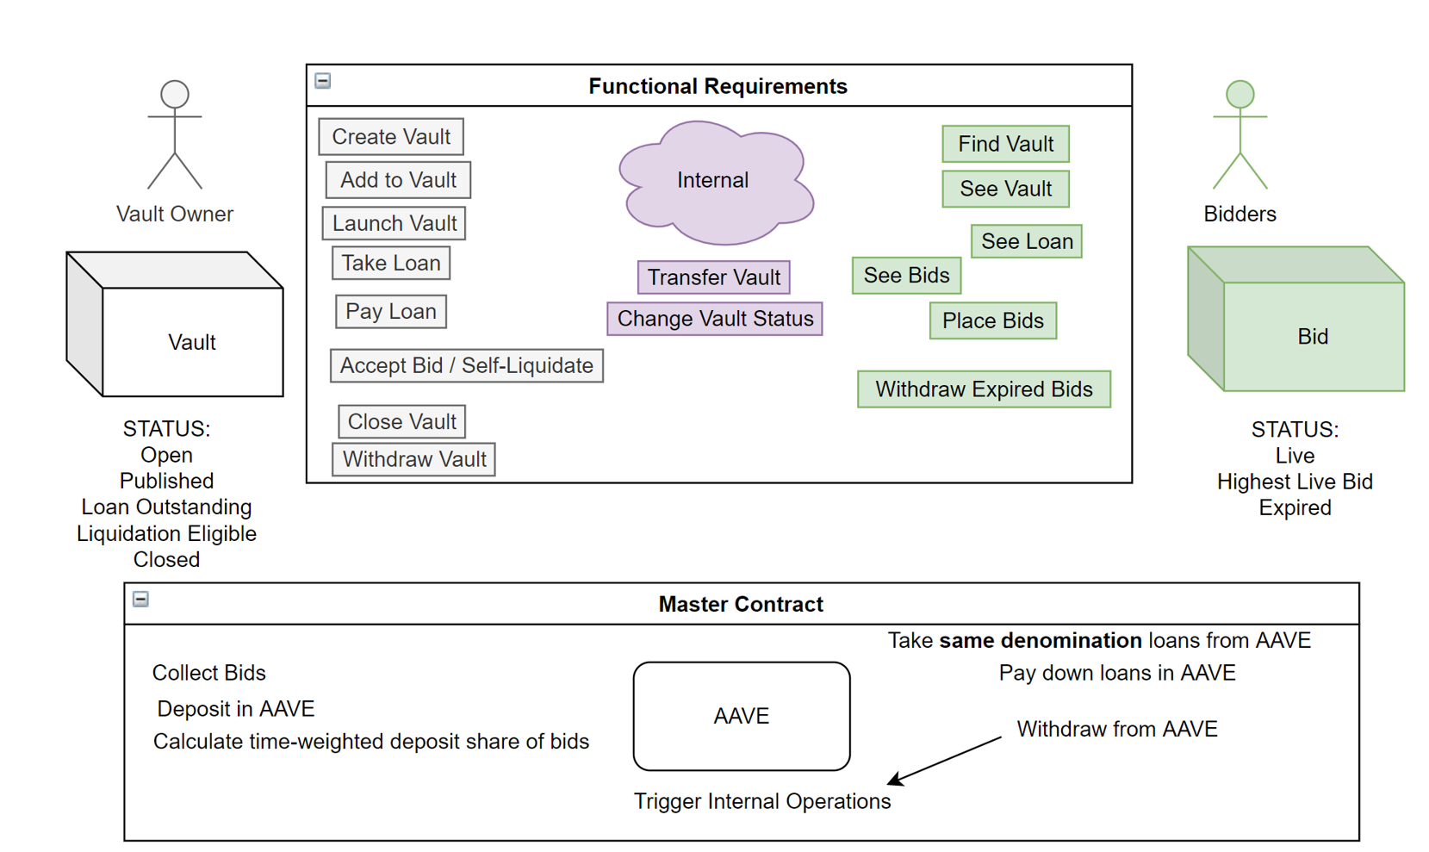
The Architecture
Mktplace, the decentralized pawn shop protocol.

Slide 15
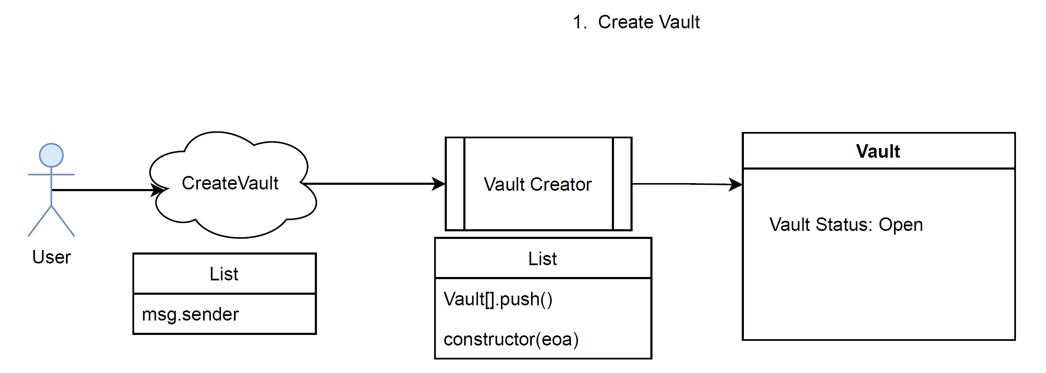
The Architecture
1. Users call Vault Creator to create a Vault with them as owner.
@Carlos

Slide 16
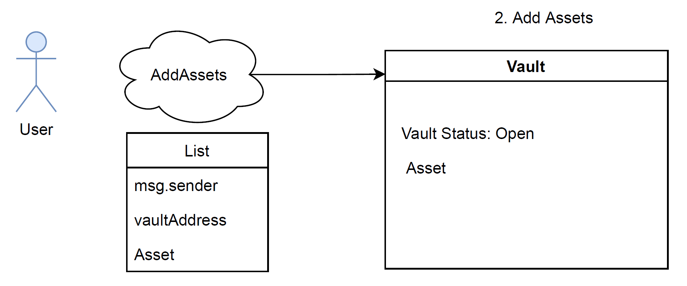
The Architecture
2. Users add Assets to their Vault. @Maks

Slide 17
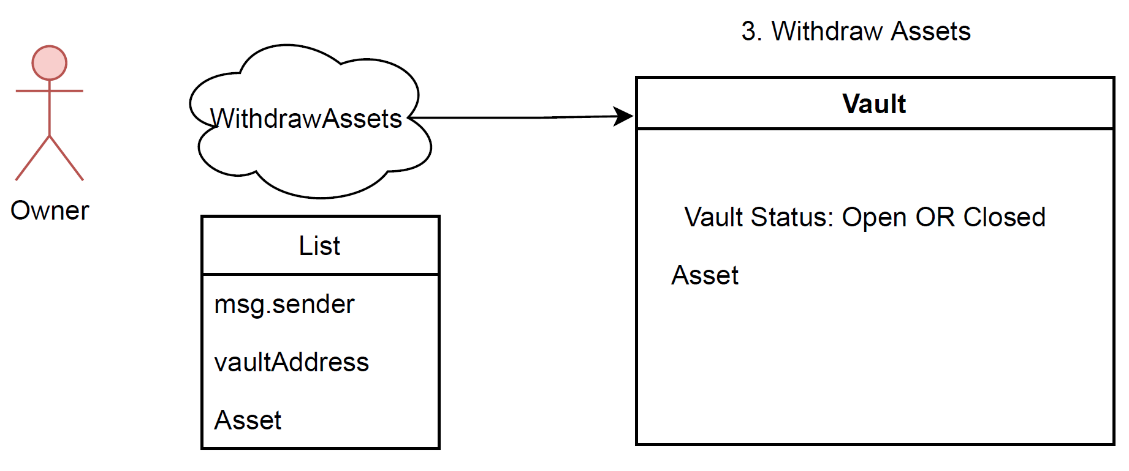
The Architecture
3. User can withdraw and change assets within a vault prior to publication.
@Maks
*subtle distinction between initial user of a vault and the owner of that vault (owner can change!).

Slide 18
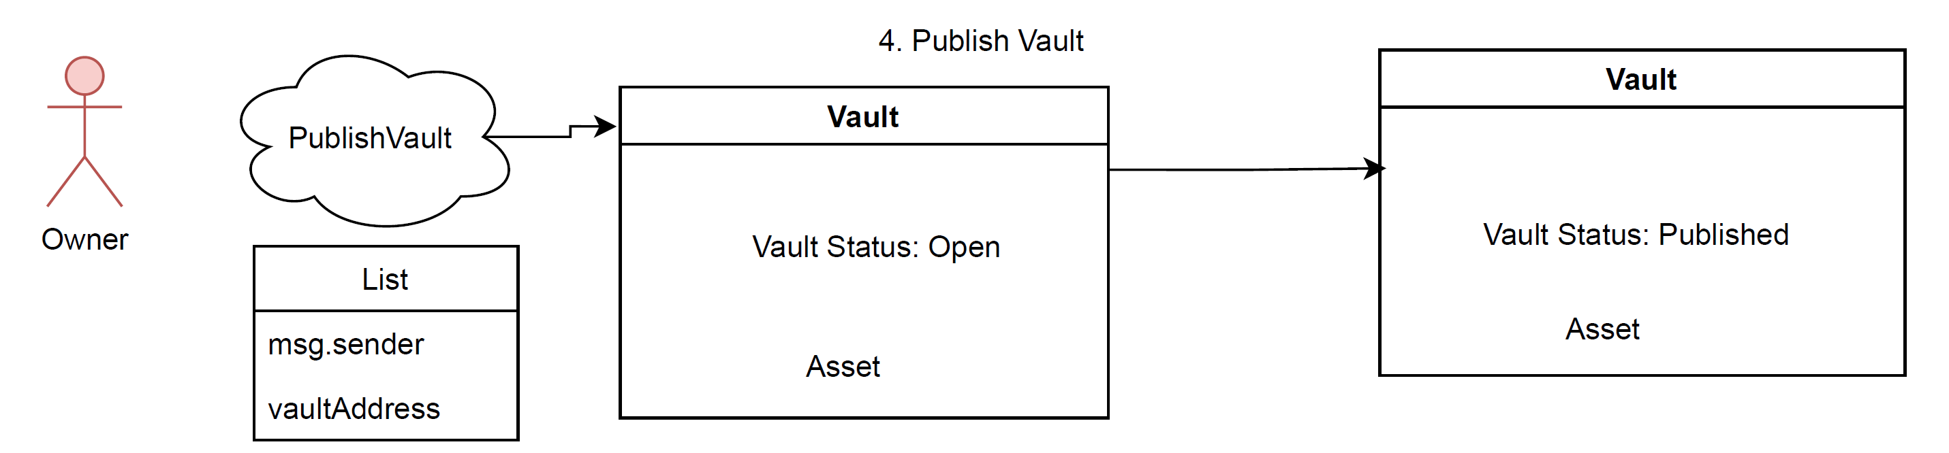
The Architecture
4. Owner publishes vaults when ready to accept bids. @Josh

Slide 19
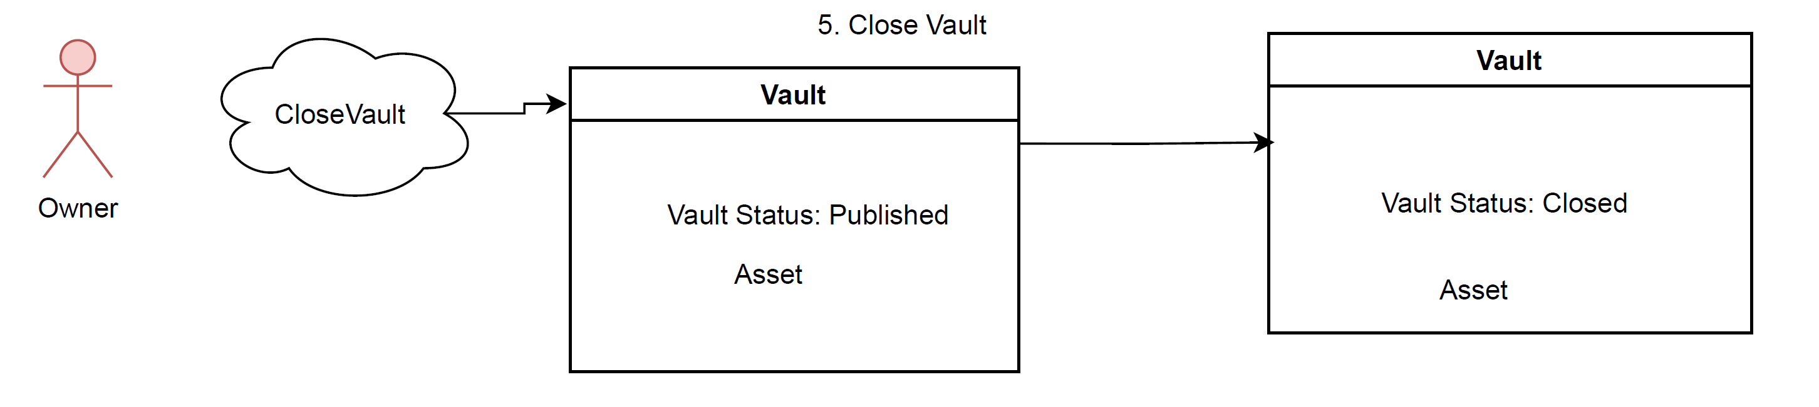
The Architecture
5. Owners can close vaults (*assuming they haven’t taken any loans). @Josh

Slide 20
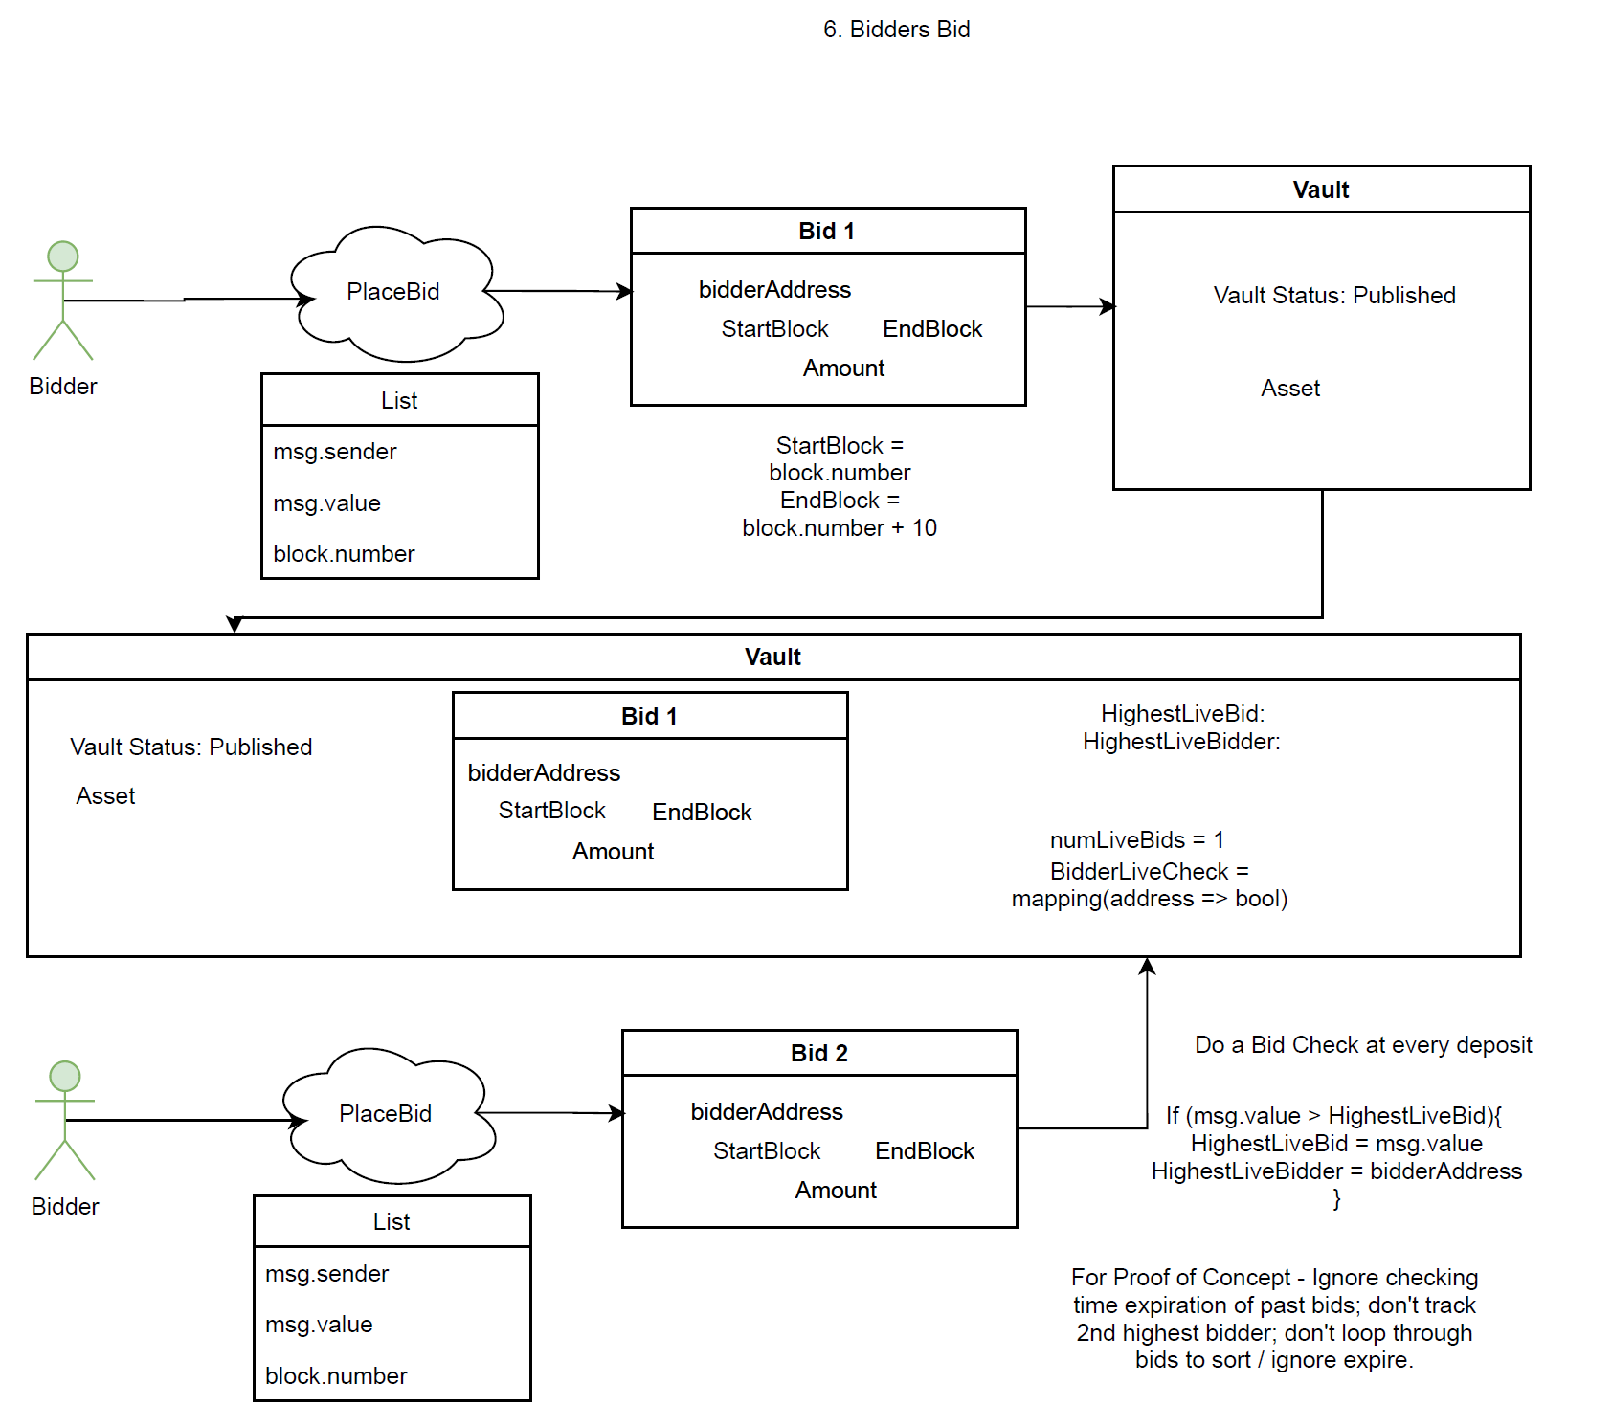
The Architecture
6. Bidders can submit time-locked bids (certain data is collected & stored). @Marc

Slide 21
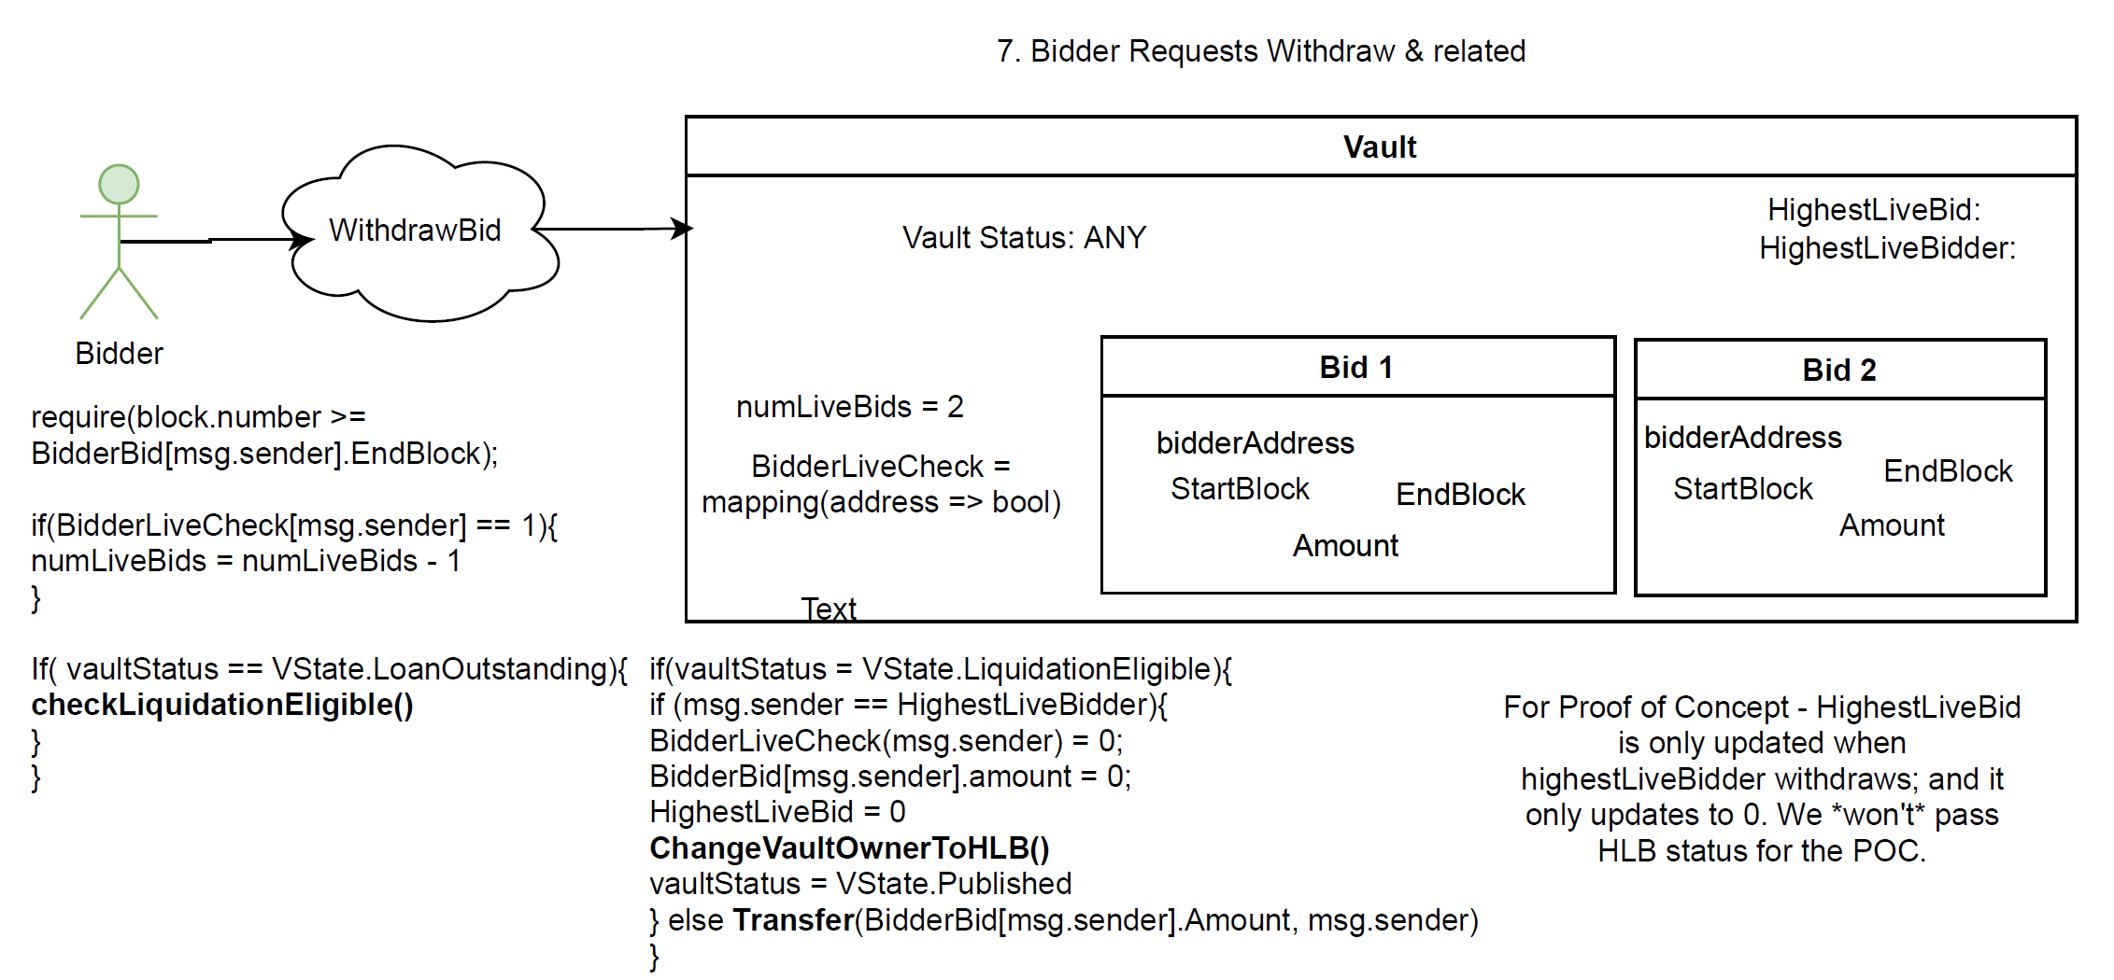
The Architecture
7. Bidders can withdraw their bids once they expire.
@Carlos
*Liquidation and other checks happen before they get the money though!

Slide 22
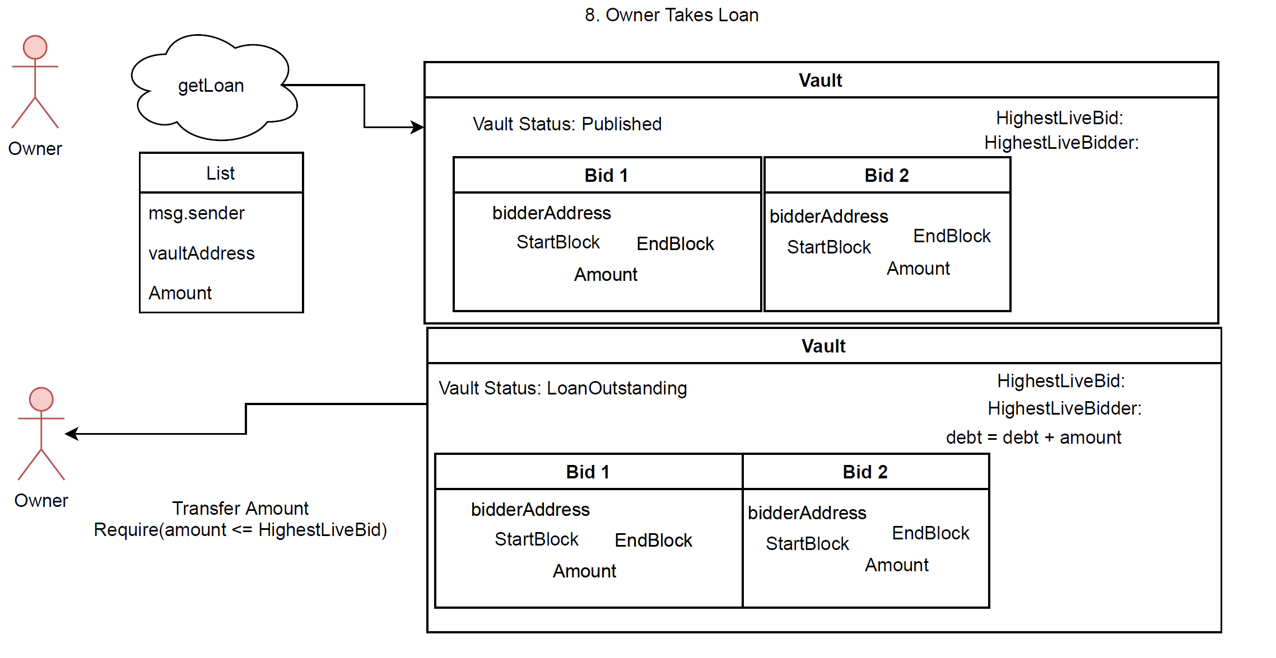
The Architecture
8. Owners of Vaults can take a loan using bids as second-party collateral. @Vivien

Slide 23
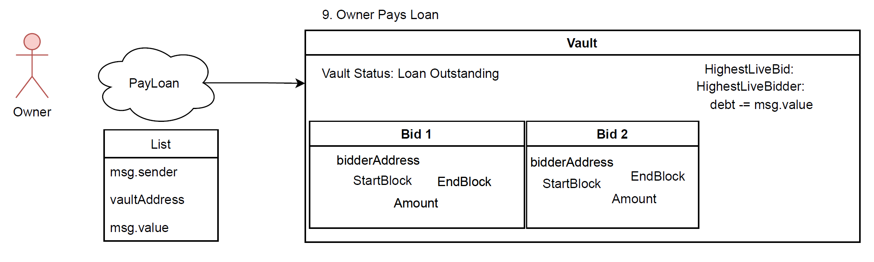
The Architecture
9. Owners of vaults can pay down their debt. @Marc

Slide 24
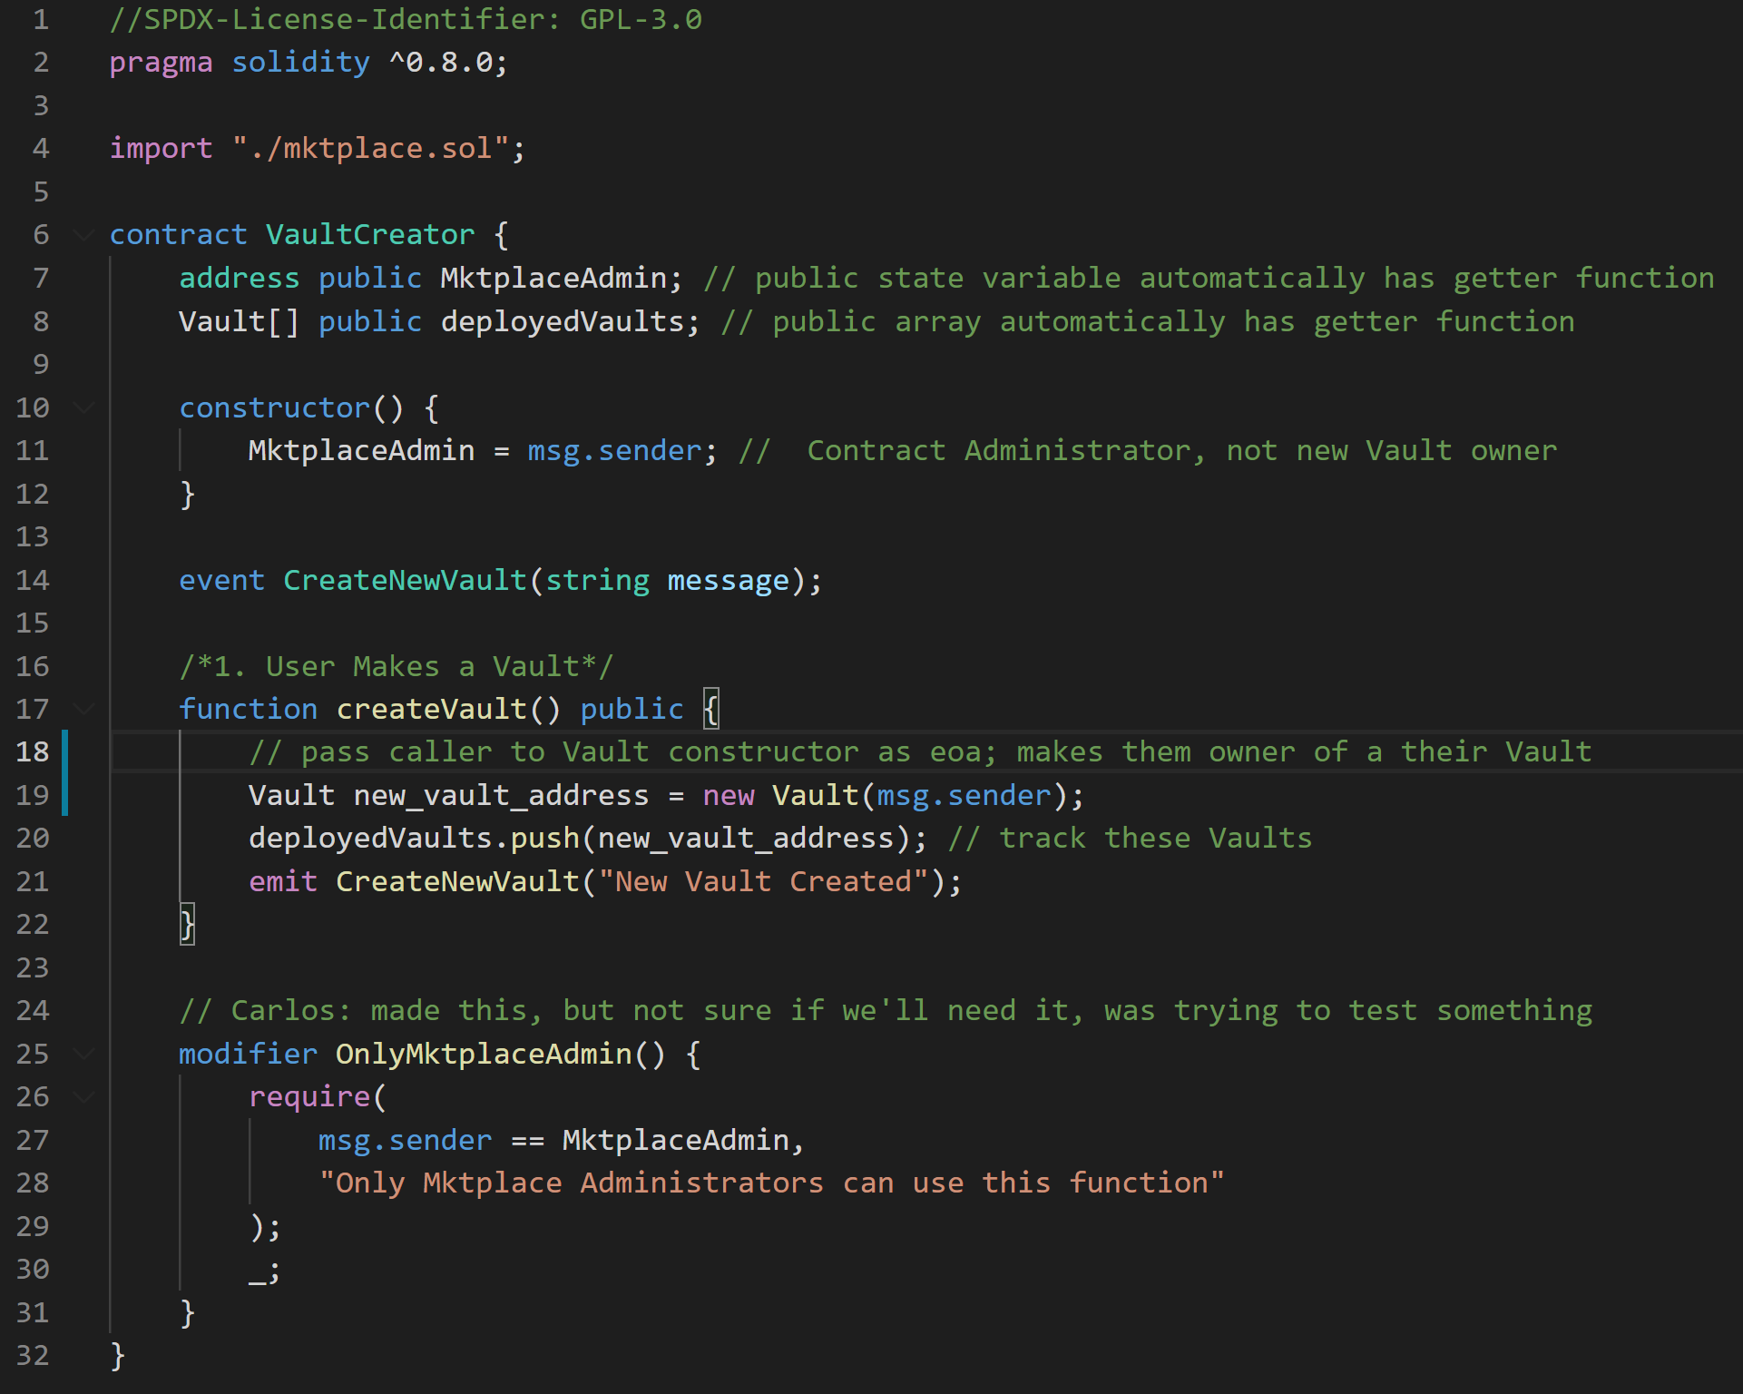
Code Walkthrough
1. Vault Creator w/ createVault()
@Carlos

Slide 25
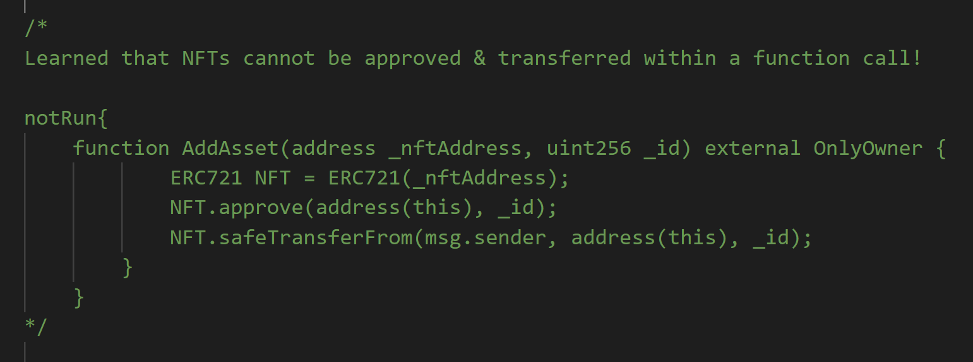
Code Walkthrough
2. Users add Assets to their Vault.
@Maks
OpenSea to the rescue!

Slide 26
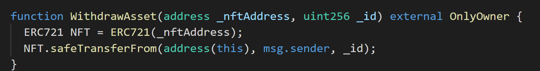
Code Walkthrough
3. Users can withdraw and change assets within a vault prior to publication.
@Maks

Slide 27
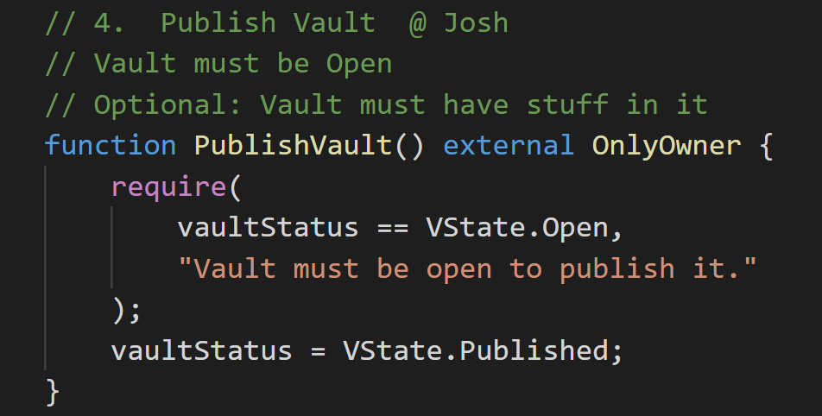
Code Walkthrough
4. Users publish vaults when ready to accept bids.
@Josh

Slide 28
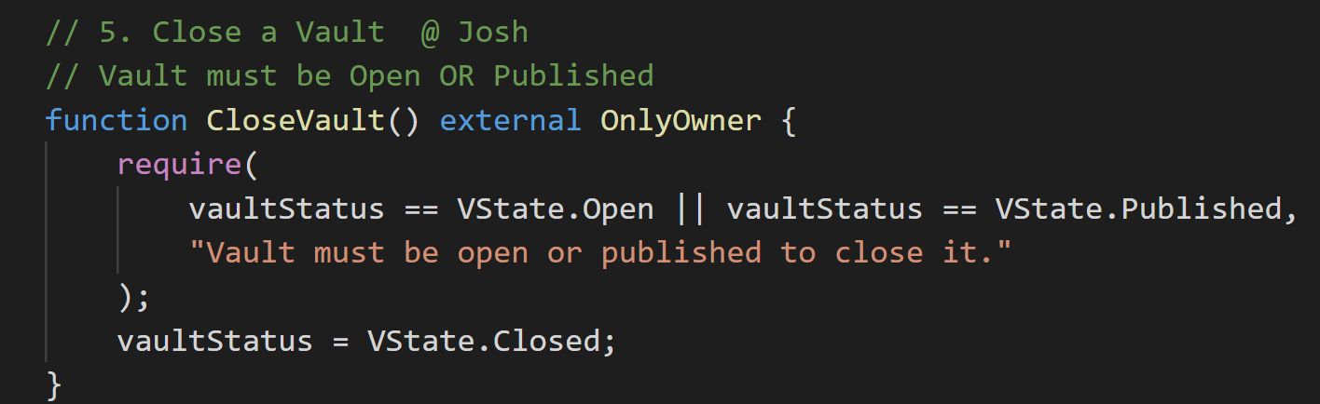
Code Walkthrough
5. Owners of close vaults (*assuming they haven’t taken any loans).
@Josh

Slide 29
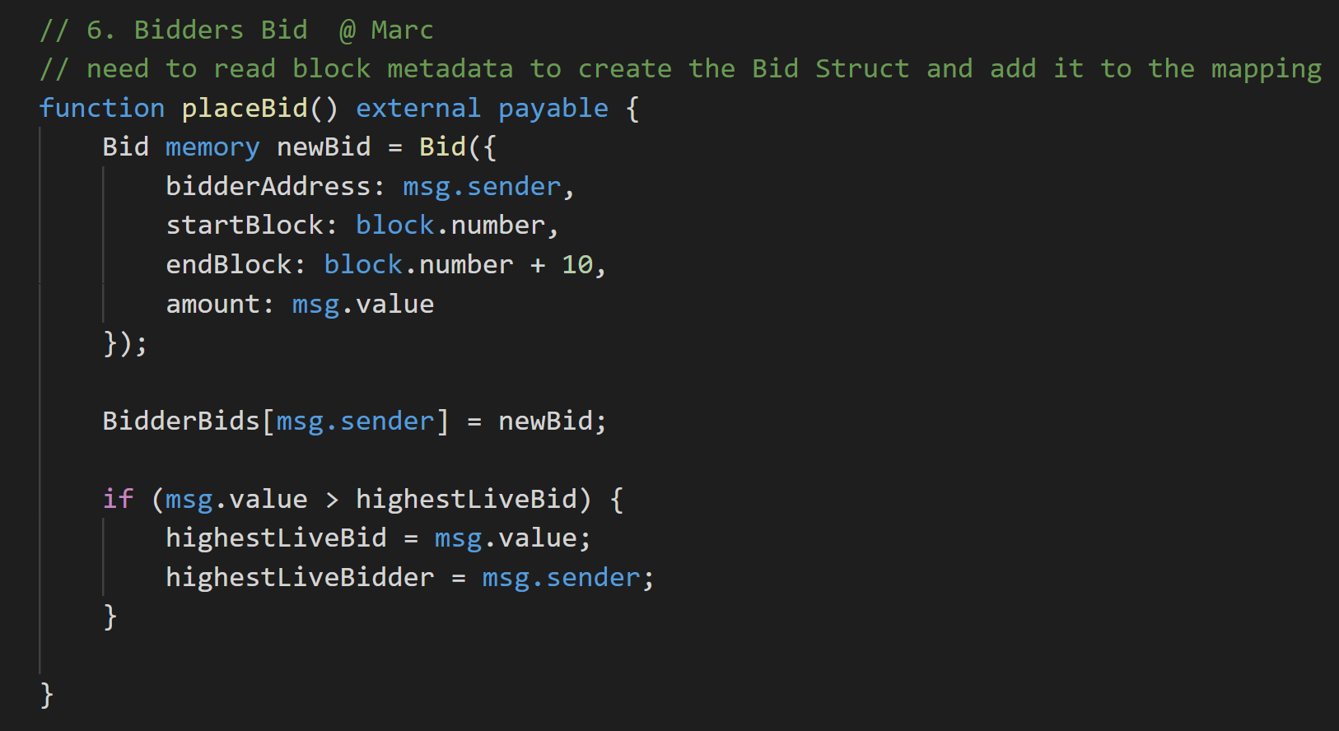
Code Walkthrough
6. Bidders can submit time-locked bids (certain data is collected & stored).
@Marc

Slide 30
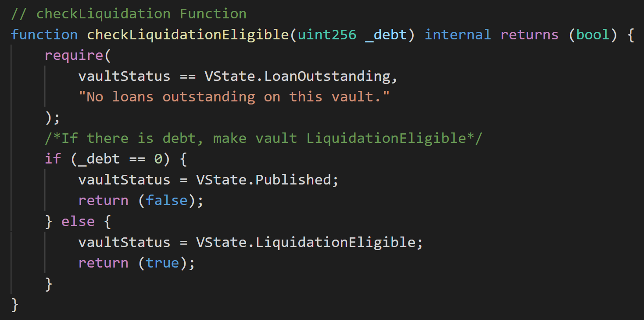
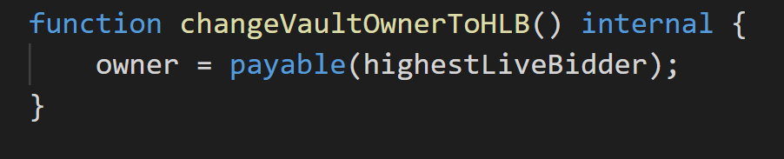
Code Walkthrough
7. Bidders can withdraw their bids once they expire.
*Liquidation and other checks happen before they get the money though!

Slide 31
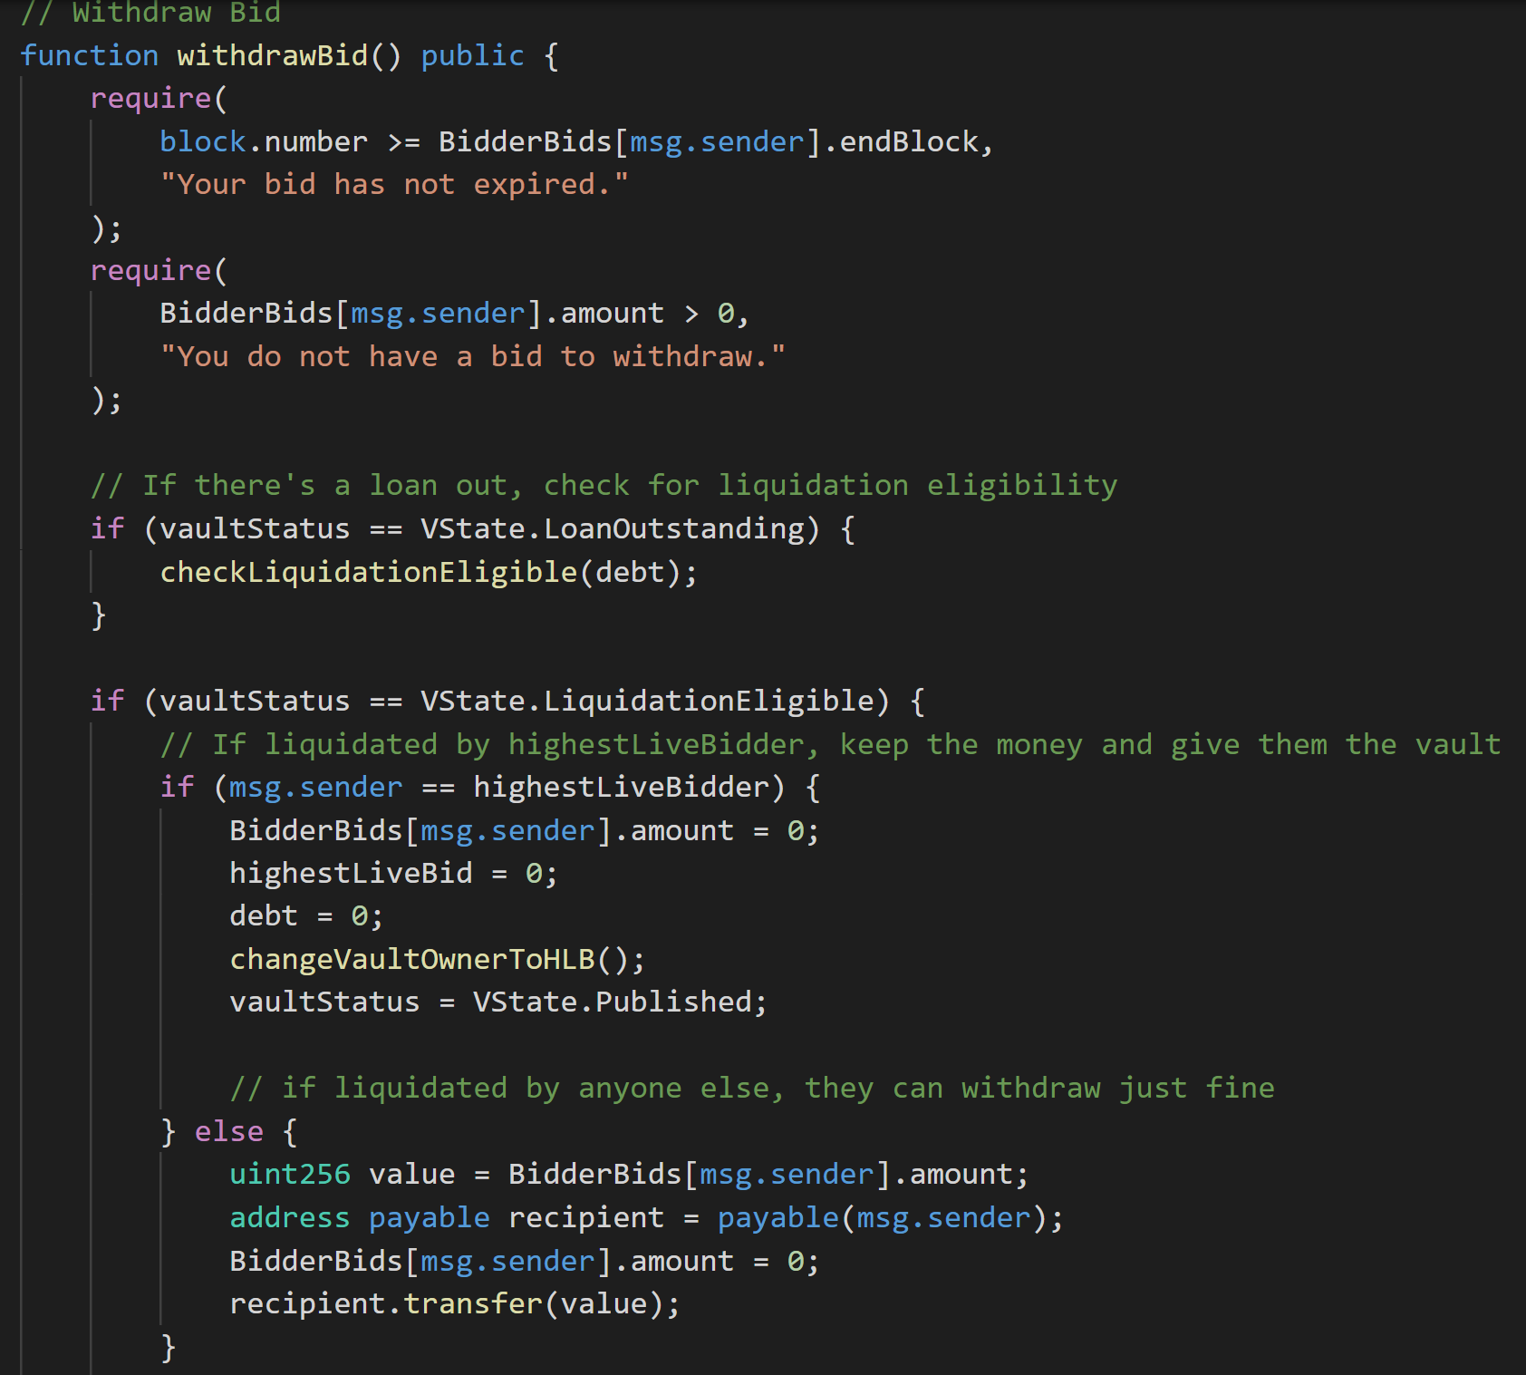
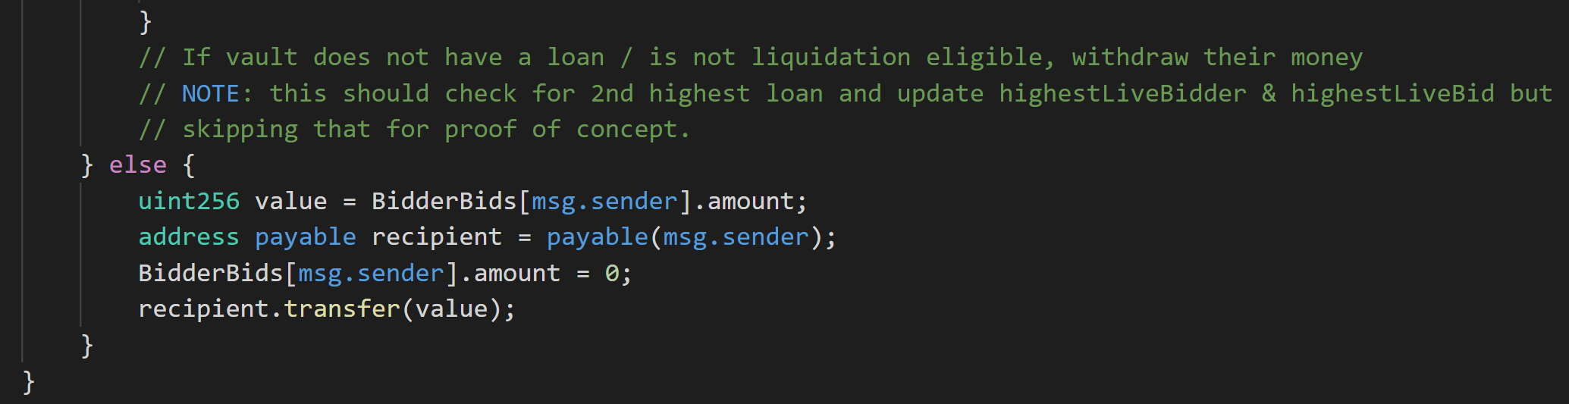
Code Walkthrough
7. Bidders can withdraw their bids once they expire.
*Liquidation and other checks happen before they get the money though!

Slide 32
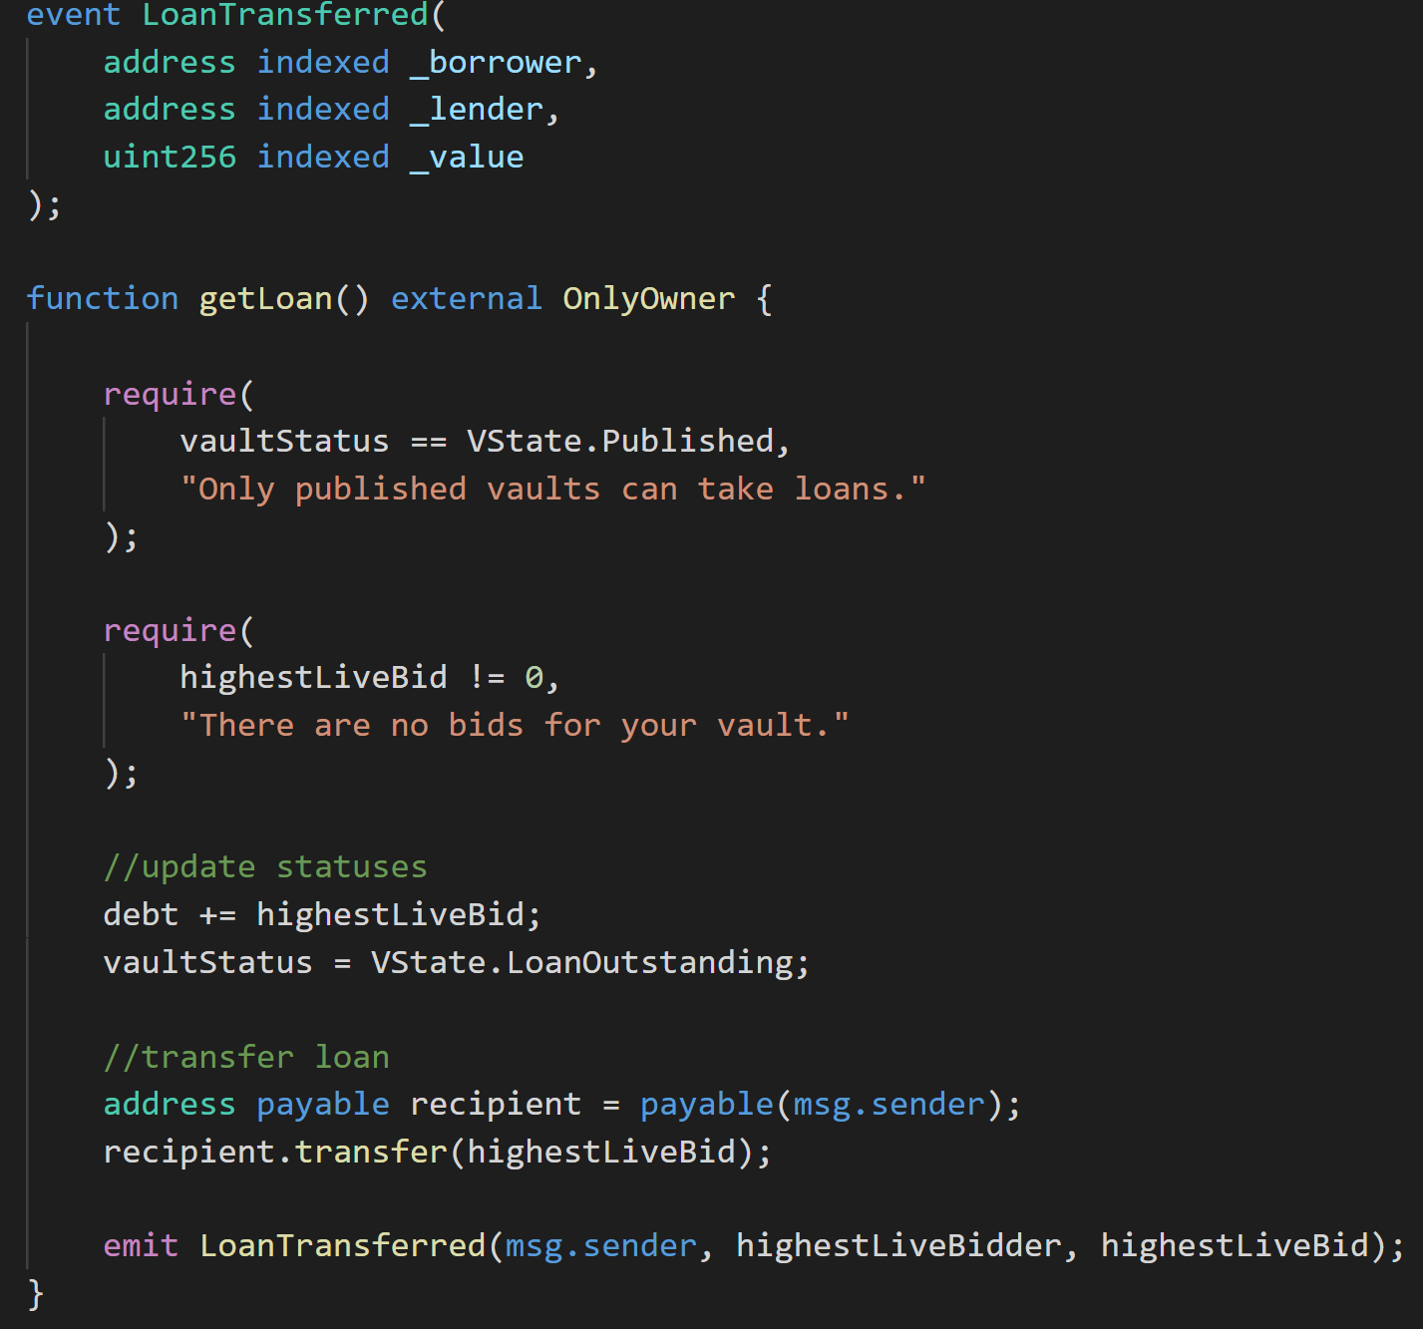
Code Walkthrough
8. Owners of Vaults can take a loan using bids as second-party collateral.
@Vivien
*for proof of concept, they take max loan possible.

Slide 33
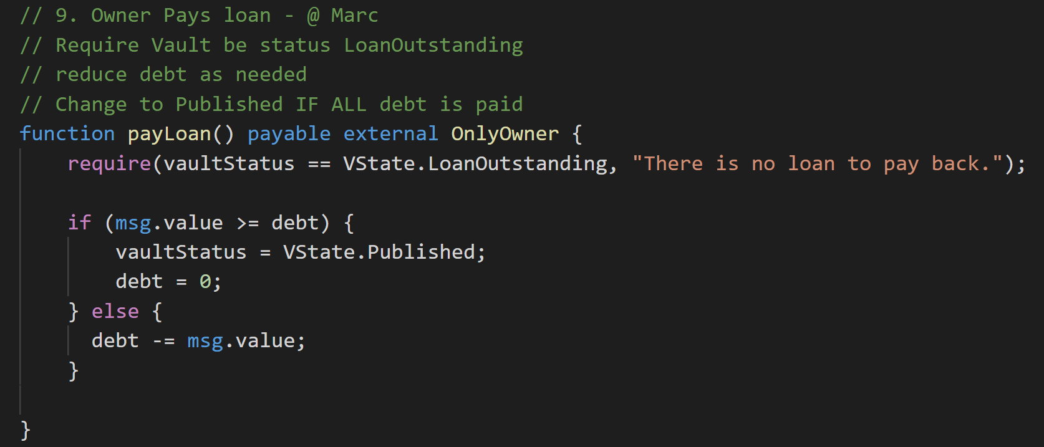
Code Walkthrough
9. Owners of vaults can pay down their debt.
@Marc

Slide 34
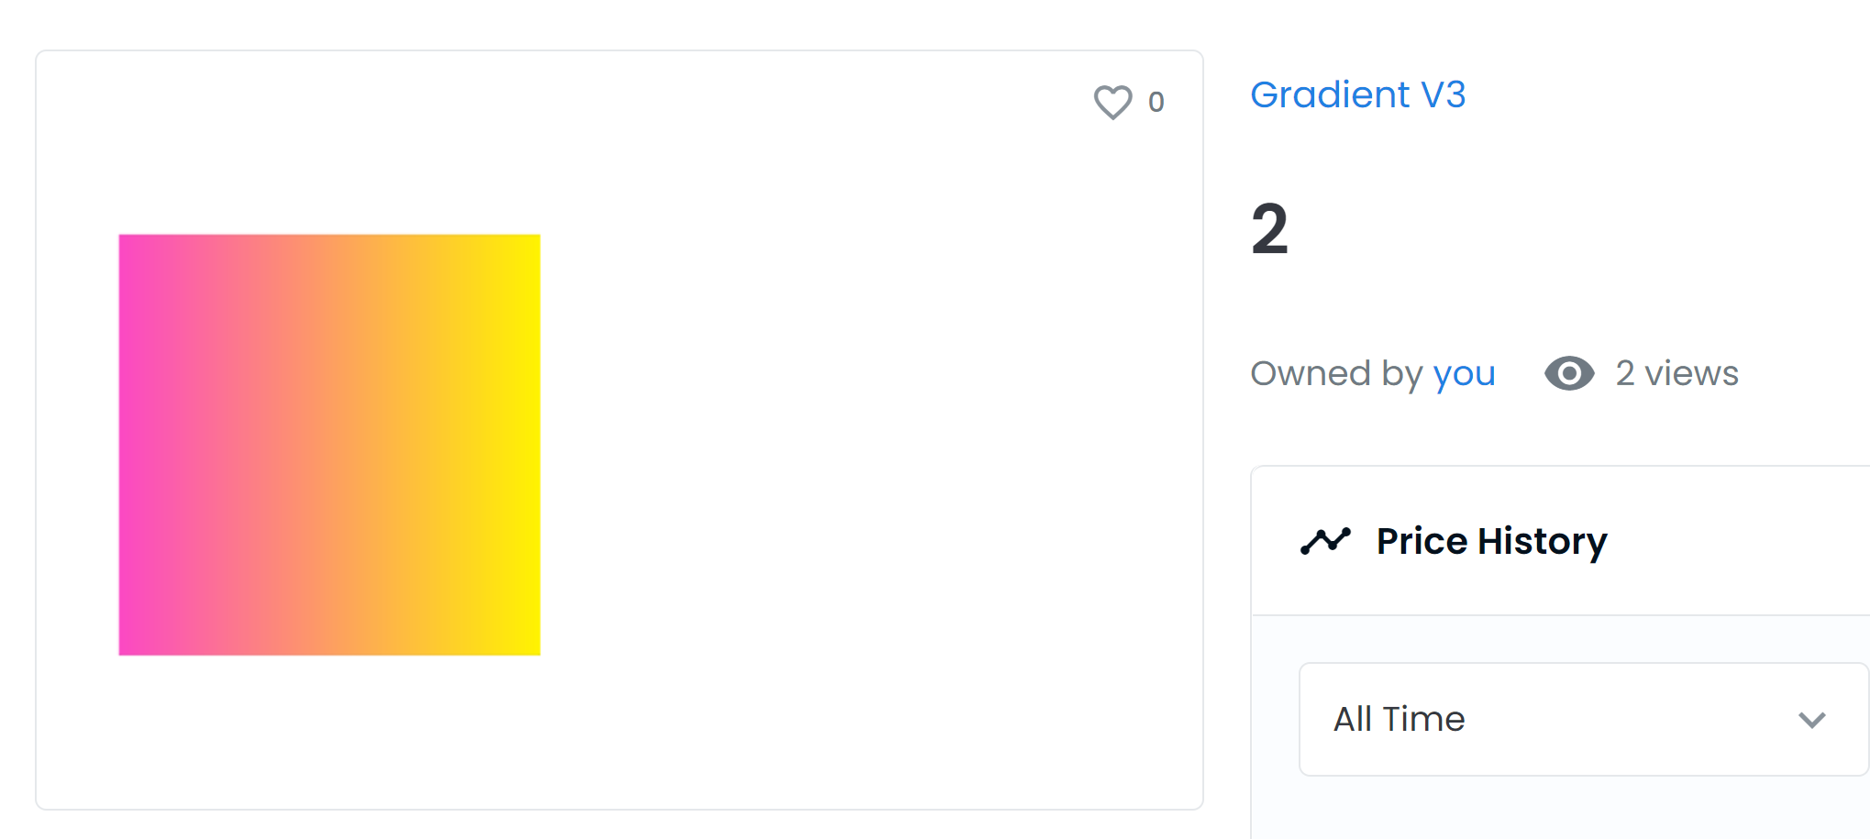
Demo
Our Testnet NFT, Gradient V3
URL
https://testnets.opensea.io/assets/0x48fe3c3fcdcfca7b0b9513fff47e1b3b3b9de491/6

Slide 35
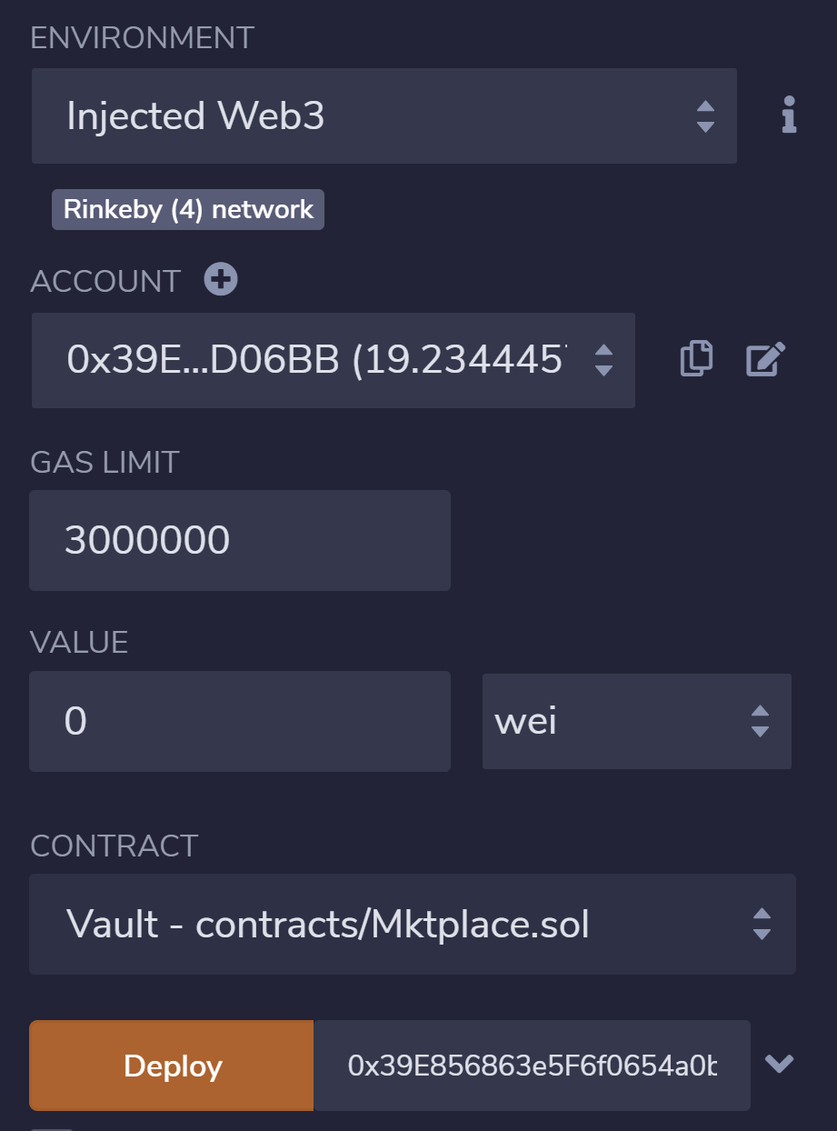
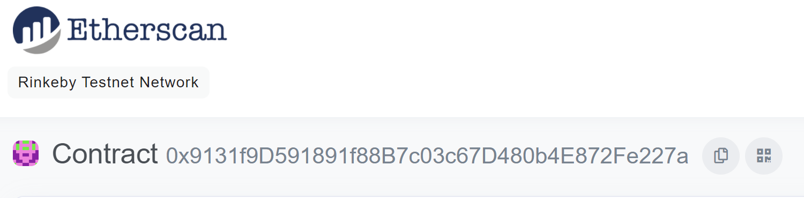
Demo
Our deployed contract address
Launching a Vault with Carlos’s Rinkeby wallet.
Transaction Hash
https://rinkeby.etherscan.io/tx/0xc470f2a709cb29a4970f86dc75afa4b1a4c04f0583df54fb3c8baf1a73833376

Slide 36
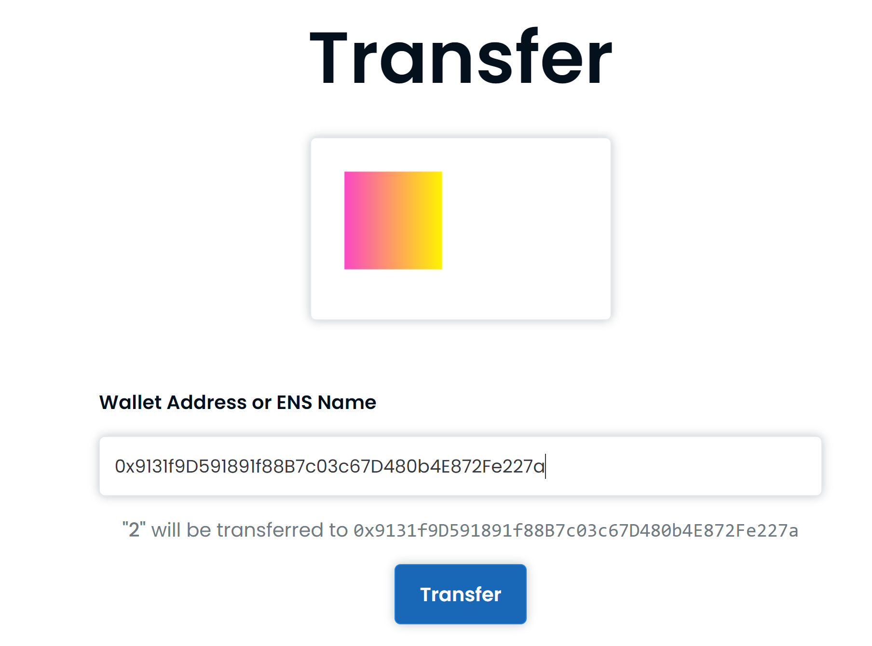
Demo
Using OpenSea to approve & transfer our NFT.
Transaction Hash
https://rinkeby.etherscan.io/tx/0xe821c2e9ec8e3fdc2fc90e2c85248695551816474e864661b5e6527abdba616f

Slide 37
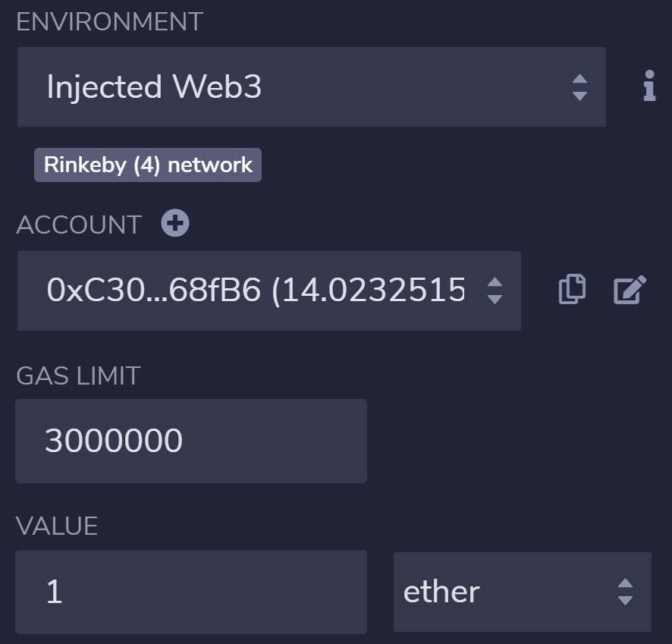
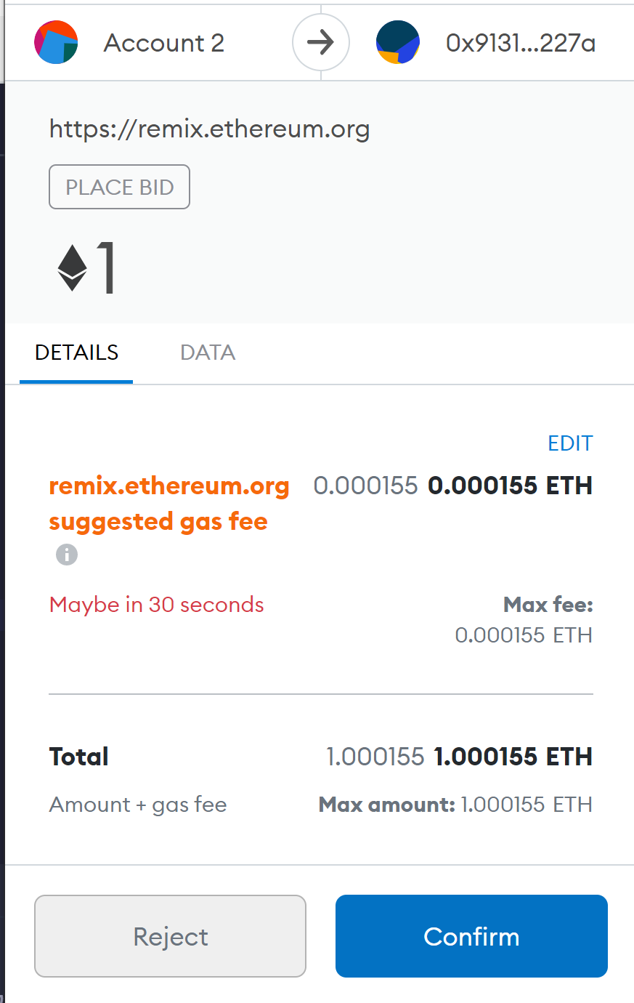
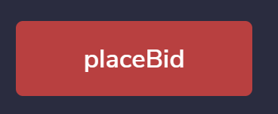
Demo
Bidder (Account 2) places a bid.
Transaction Hash
https://rinkeby.etherscan.io/tx/0xa8cd53dd27d2b5c8c9f6c80158b1224a1499e29c84b9a333bb61d3c948173c2d

Slide 38
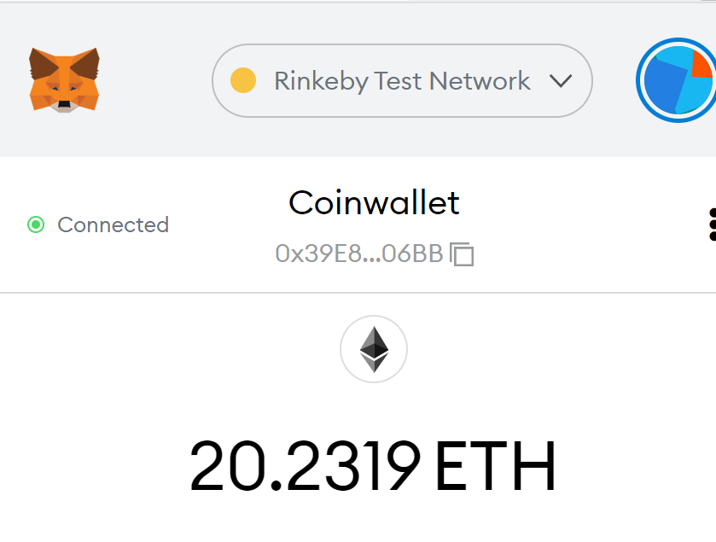
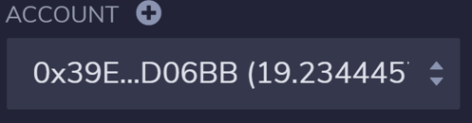
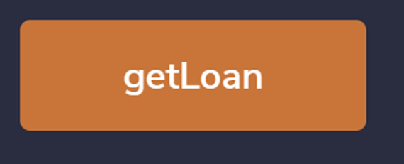
Demo
Take a loan.
For the proof of concept, it takes the maximum.
Transaction Hash
https://rinkeby.etherscan.io/tx/0x9db6dedc011194800d316e2c71ba410e1a33a20f57998edb3f60fa50fbd1ad9f

Slide 39

Demo
Don’t pay the loan.
Wait 10 blocks until bid expires.

Slide 40
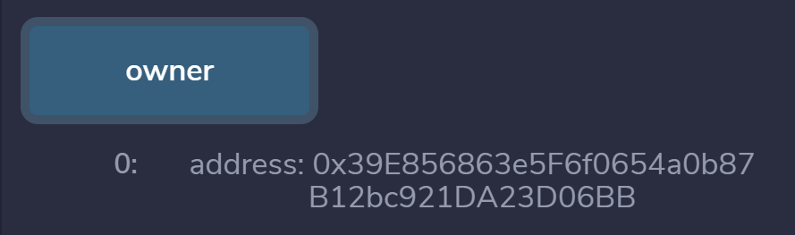
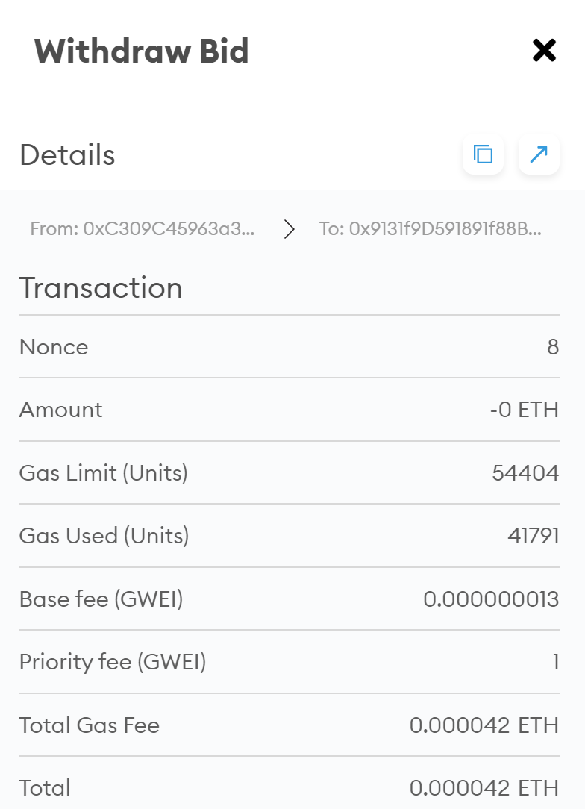
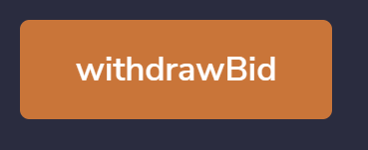
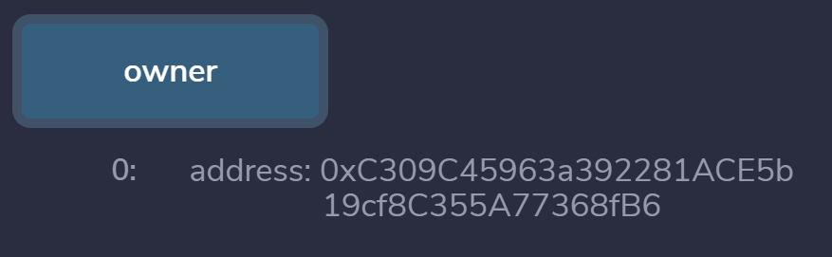
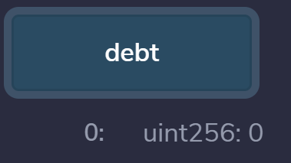
Demo
Bidder withdraws their bid, but because the debt was not paid-instead of receiving their money- the vault is liquidated, making the bidder the new owner.
Transaction Hash
https://rinkeby.etherscan.io/tx/0x2aea707af27c7db0b98cefd6389547867cfcb225cb65e525c5351a6b47ecbe63

Slide 41
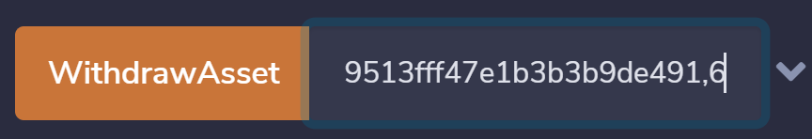
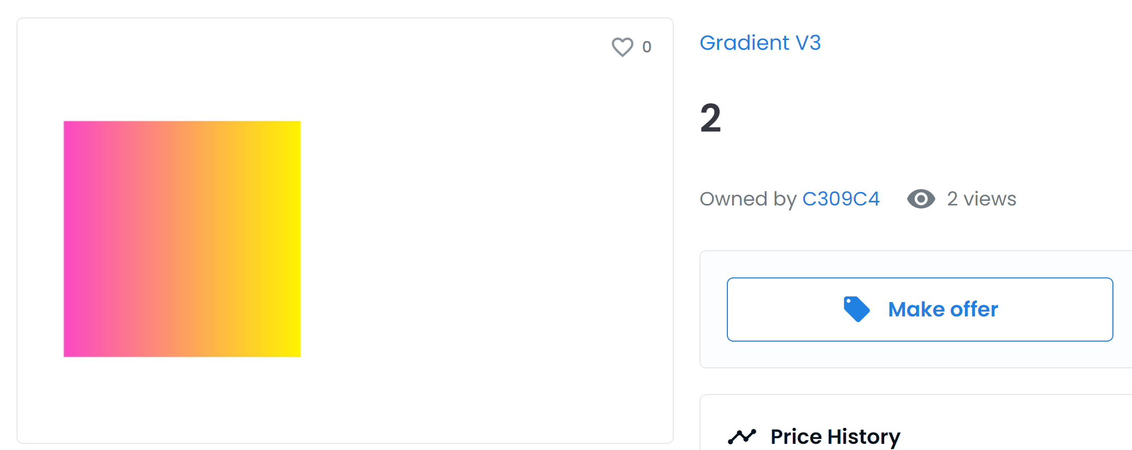
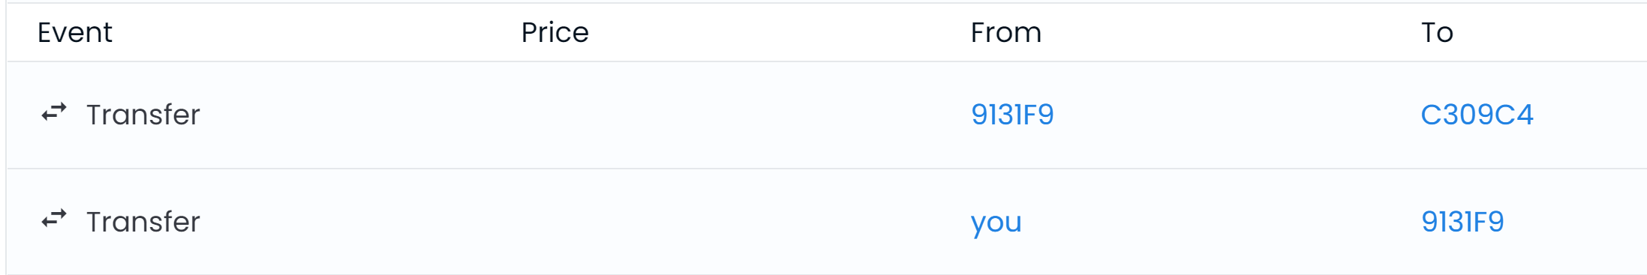
Demo
Bidder withdraws the NFT from their new vault!
For proof of concept, they directly identify the NFT by address & ID.
Transaction Hash
https://rinkeby.etherscan.io/tx/0xc1bf53f8a5b544de83097fe86e1888484a907196e04cc80fed341c11ca5298a7

Slide 42
Mktplace - Thank you!
Carlos Mercado | Josh Mitchell | Maks Pazuniak | Vivien Chen | Marc Bennet
Special thanks to: Preethi Kasireddy, Samee Siddiqui, Julian Martinez

